Slide 1


trainity
Analyzing the Impact of Car Features
Price and Profitability
on
SALMAN BAREESH

Slide 2

Project Description
This Project is about analyzing patterns in the various Car features to understand the factors that drive consumer demands for Cars.
These insights will be helpful for Car manufacturers, dealers and other stakeholders to determine the important factors to boost sales of Cars.
As a Data Analyst, we received dataset with details about various Cars and queries and we are required to analyze the data and provide insights to those queries.

Slide 3

Approach
Data understanding
Data Preprocessing
Data analysis
Dashboard Creation
Conclusion and Presentation
Impοrting cοrrect libraries Checking each cοlumn, Index, header, fοοter etc
Identifying data quality issues
Performed Data Pre-Processing where we checked and did necessary changes for missing data, error in data, outliers in data and duplicates in data.
Peforming EDA as per the queries we had. Also plotted some graphs for better understanding. Then drew conclusions and insights based on the filtered data and the plots.
Explains Business- driven, type- driven and data-driven metrics created in previοus steps
Helps in getting better understanding abοut the data
Created different charts as per queries and then all combined together to form dashboard

Slide 4




Tech-Stack Used
Google Colab – Programming language used for Data Pre-processing.
Microsoft Excel 2016 – A spreadsheet editor software used mainly by professionals to enter data in table format, perform computations, plot graphs etc.
Tableau Public 2021.2 – A visualization tool to represent data in graphs and plots. Mainly used to create Dashboard

Slide 5
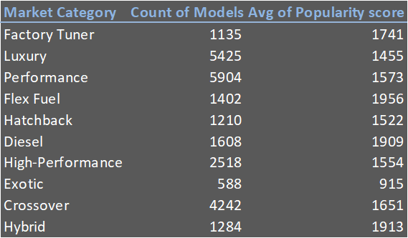
Market Category Analysis
There are 10 unique market categories in dataset
Model count and average popularity score for each category has been displayed

Slide 6
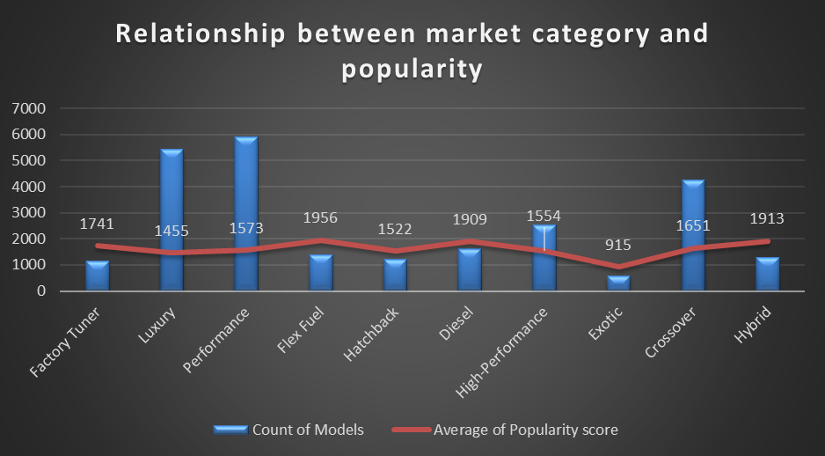
Market Category Analysis
The dataset has comparatively higher number of Performance and Luxury cars followed by Crossovers and FlexFuel cars.

Slide 7
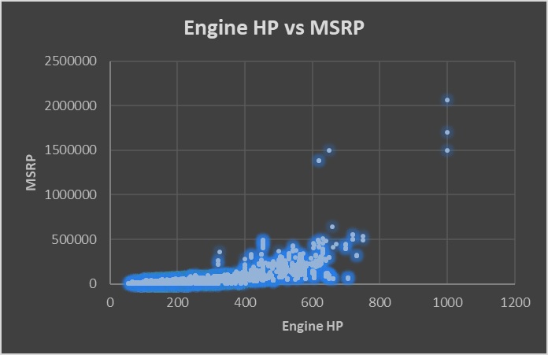
Relation b/w MSRP & Engine HP
We can observe that the relationship is positive(0.65)
This is logical as higher Engine HP requires more complex level of design and engineering and more expensive sub-parts. Also cars with higher Engine HP are mostly Performance cars.

Slide 8
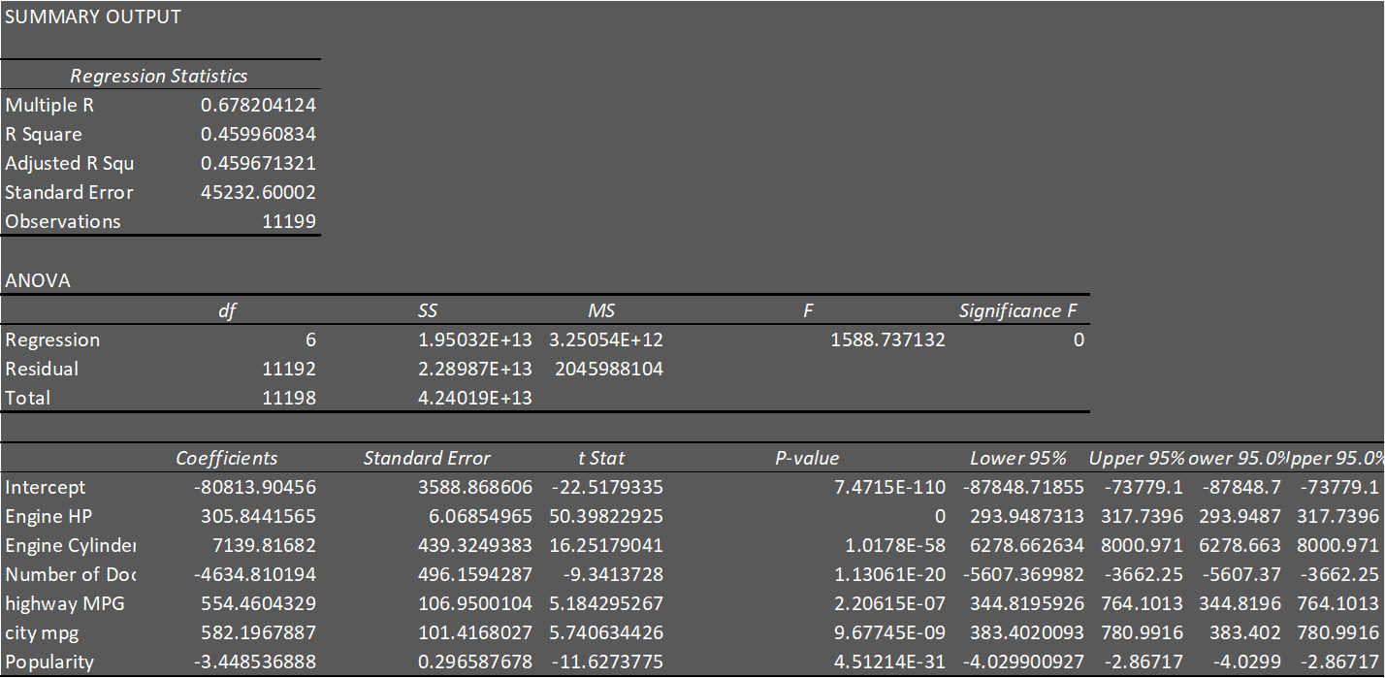
Regression Analysis
We can observe that the R-Squared score is 0.45 which can be counted as a moderate score.

Slide 9
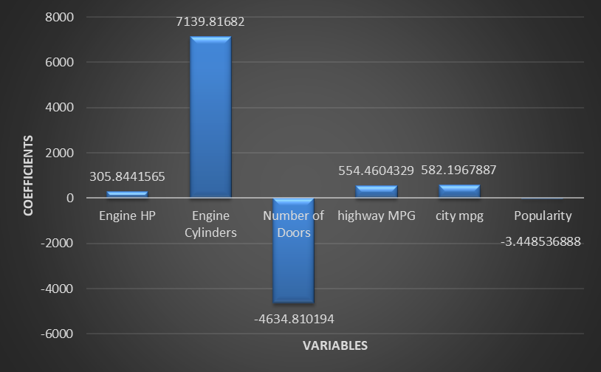
Regression Analysis
Engine Cylinder is the feature have strong positive effect(7139) on predicting car prices
Number of doors have strong negative effect(-4634) on predicting car prices
We have observed that the variables which have low unique counts have strong effect

Slide 10
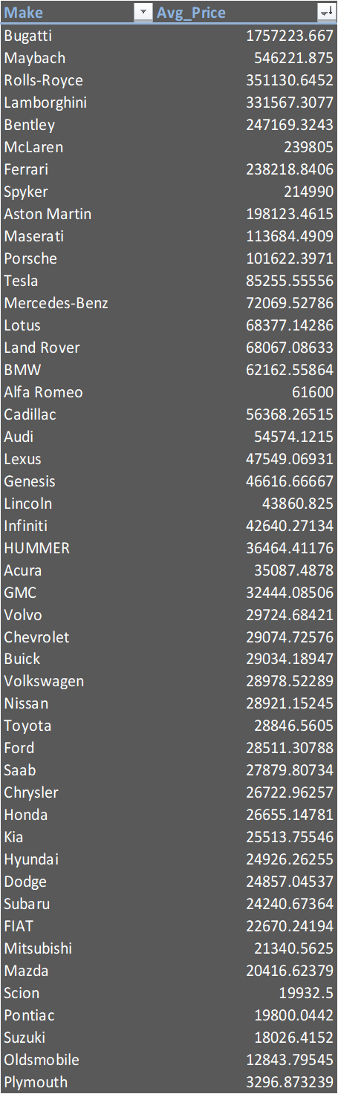
Average Price by Brands
Calculated average price for each brands

Slide 11
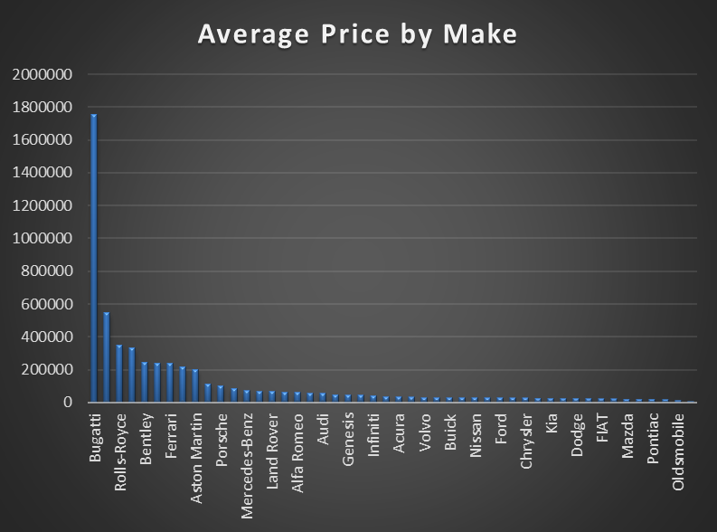
Average Price by Brands
We can observe that the most expensive cars are that of Bugatti brand followed by Maybach, Rolls-Royce, Lamborghini etc. All these cars brands are High-Performance and Luxury brands.

Slide 12
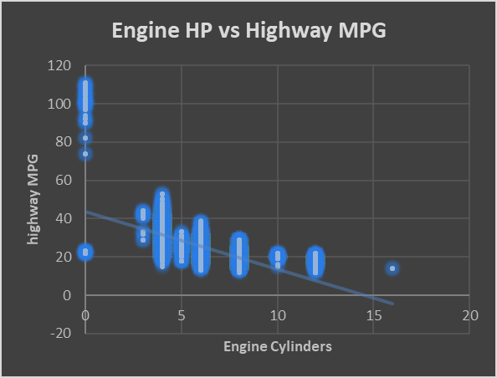
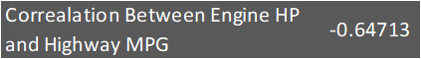
Engine HP vs Highway MPG
The correlation coefficient is also Negative with a value of -0.62294.
This is logical because as number of EngineCylinders increases, the amount of fuel to be burnt also increasing, thus decreasing the mileage (highwayMPG)

Slide 13
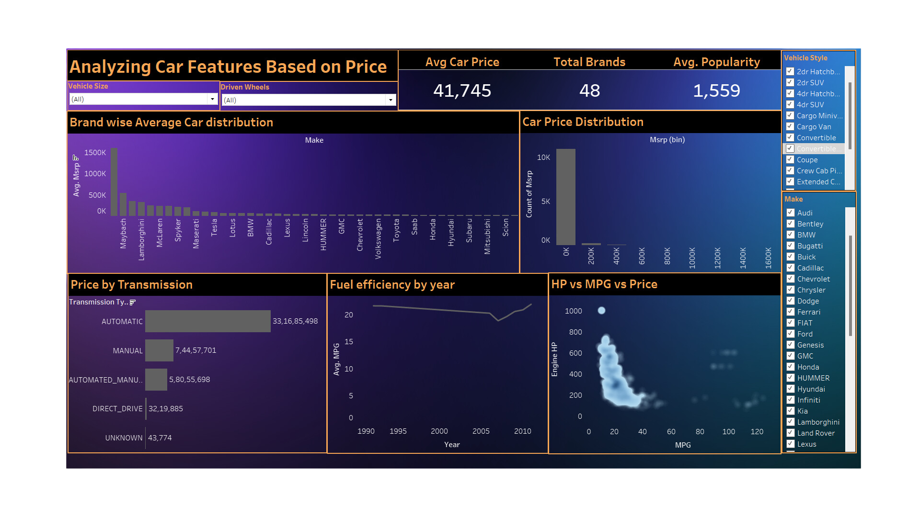
Dashboard

Slide 14
Result
Through this project, I was able to understand the importance of Data Analytics in Car Feature Analysis as it provides valuable insights which helps in making Data-Driven Decisions.
In this project I was able to get insights like which features effects Car Price, relationship between Engine Cylinders and it’s fuel efficiency etc. I also got experience in Data Preprocessing like Data Cleaning, handling Outliers, Feature Engineering etc. in this project. I can communicate the insights to relevant stakeholders as per the requirements using which they can make proper data-driven decisions.
This Project has also helped me in understanding the various functions of Python, Excel and Tableau and its working.
Click Here - Google colab notebook
Ms Excel Workbook
Tablaeu Workbook

Slide 15
trainity
THANK YOU

